Slide 1
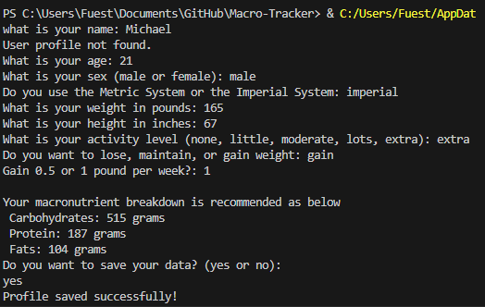
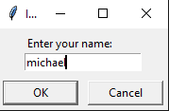
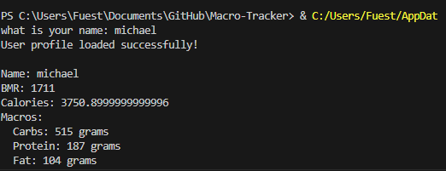
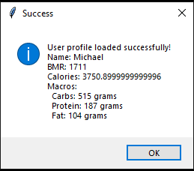
MacroTracker
An easy way to calculate your calories and macronutrient intake for the day!
By: Michael Fueston
https://github.com/ksu-is/Macro-Tracker

